Slide 1
Autonomous Car Project
Done by :
• Amr Mohamed
• Kariman Karam
• Mohamed Samy
• Mohamed Ehab

Slide 2
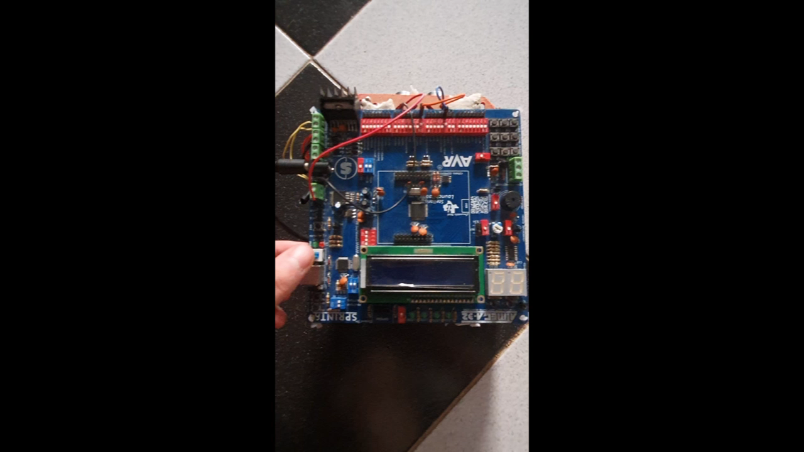
Project Demo:

Slide 3
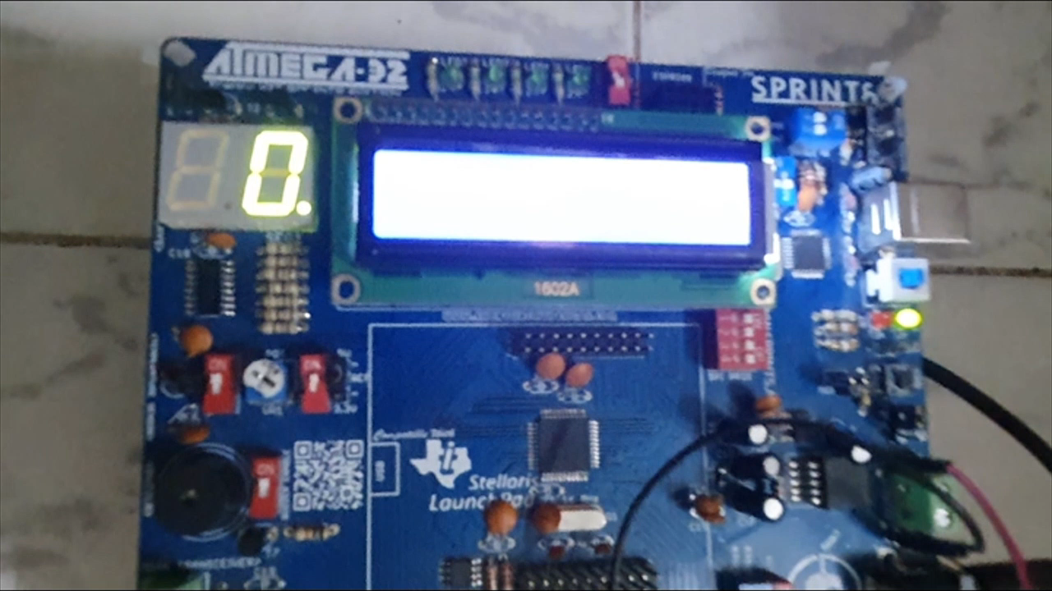
Project Demo 2:

Slide 4
Static Design:
Services | APP | LIB
 | ECUAL
 | MCAL
Microcontroller
CarControl
GetDistance
DisplayDistance
HBridgeControl
Ultrasonic
LCD
HBridge
STD_TYPES
TDelay
SW_ICU
BIT_MANIPULATE
EX_INT
Timer
DIO
PWM

Slide 5
Circuit Diagram:

Slide 6
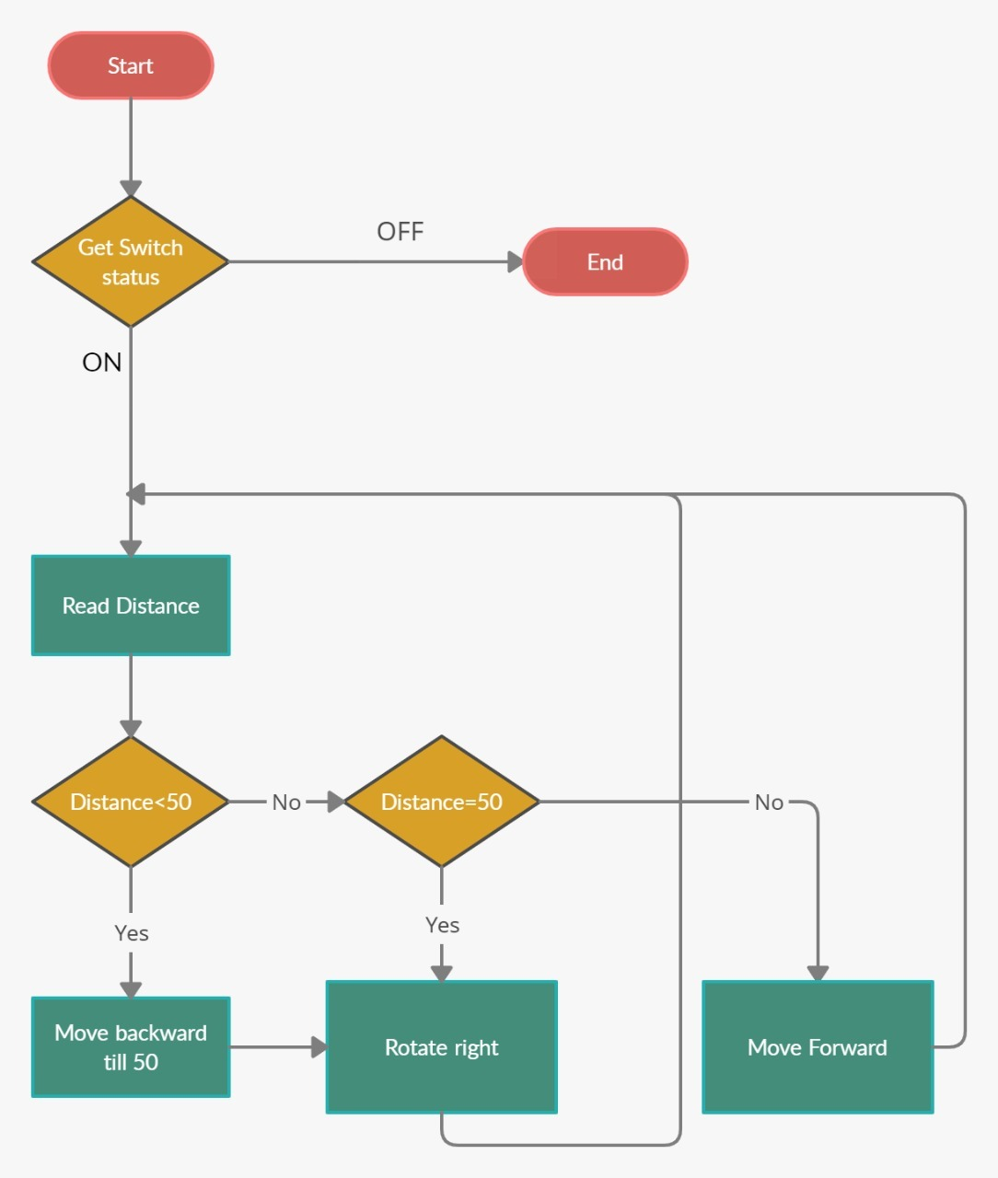
Application Flow Chart :

Slide 7
DisplayDistance Flow Chart :

Slide 8
GetDistance Flow Chart :

Slide 9
HBridgeControl Flow Chart :

Slide 10
Test Cases :
•Car moving forward and the obstacle is 50cm apart : Expected result : The car moves to the right and move forward Actual result : The car moves to the right and move forward
•Car moving forward and the obstacle is more than 50cm distance apart :
Expected result : The car keeps moving forward till the obstable is 50cm apart
Actual result : The car keeps moving forward till the obstable is 50cm apart

Slide 11
Test Cases : (Cont.)
•Car moving forward and the obstacle is less than 50cm distance apart :
Expected result : The car moves backward till the distance become more than 50 cm Actual result : The car moves backward till the distance become more than 50 cm

Slide 12
Roles and Responsibilities :
Drivers :
Kariman Karam : External Interrupt , H-Bridge
Amr Mohamed : Ultrasonic , ICU
Mohamed Samy : DIO , PWM
Mohamed Ehab : LCD , Timers
Application Software : Mohamed Samy, Kariman Karam
Presentation : Mohamed Ehab

Slide 13
Roles and Responsibilities : (Cont.)
Hardware:
Mohamed Samy
Static Design:
Amr Mohamed
Simulation Video:
Mohamed Samy

